Slide 1




AT82.02
Data Modeling and Management
Unit 3-1: Data Sharding & Replication Models
Chutiporn Anutariya (chuti at ait dot ac dot th)

Slide 2
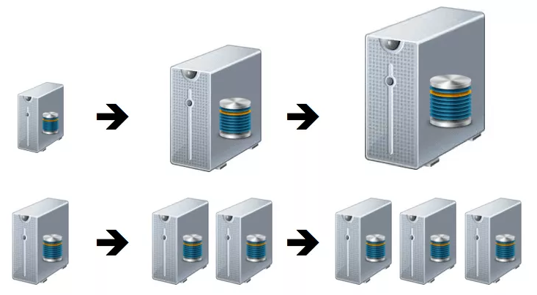
Scale UP vs. Scale OUT
RECAP

Slide 3
Distribution Model
Scale out is more appealing since we can run databases on a cluster of servers.
Depending on the distribution model, we can obtain a data store that can give us the ability:
To handle large quantity of data,
To process a greater read or write traffic, or
To have more availability in the case of network slowdowns of breakages
However, running over a cluster introduces complexity.

Slide 4
Distribution Model
Sharding
Replication

Slide 5
Sharding vs. Replication
Sharding distributes data across multiple nodes. So each node acts as a single source for a subset of data.
Replication copies data across multiple nodes. So each bit of data can be found in multiple places.

Slide 6

Distribution Models
Single Server
Sharding
Master-Slave Replication
Peer-to-Peer Replication
Combining Sharding and Replication

Slide 7
Single Server
First and simplest distribution option
no distribution at all
Run the database on a single machine that handles all the reads and writes.
This option eliminates all the complexity that other options introduce.
Easy for operational people to manage.
Easy for application developer to understand.

Slide 8
Distribution Models
Single Server
Sharding
Master-Slave Replication
Peer-to-Peer Replication
Combining Sharding and Replication

Slide 9
DATA SHARDING: WHAT IS IT?
Database partitioning is the process of making data splits into a database in order to distribute large amounts of data into smaller segments and can be distributed among two or more unique servers.
Each fragment can be a table, or a different physical database maintained on a separate instance of the database server.

Slide 10
TYPES OF SHARDING
Vertical sharding
Horizontal sharding
Vertical partitioning is a method of storing data from different columns into separate fragments.
Horizontal sharding is an arrangement that is carried out on condition that the rows of a database table are linked in a distinct way.
Domain specific sharding
The term Domain specific sharding is used when a logical division is drawn within the application data, storing it in different. Generally, this type of division is implemented at application level.

Slide 11
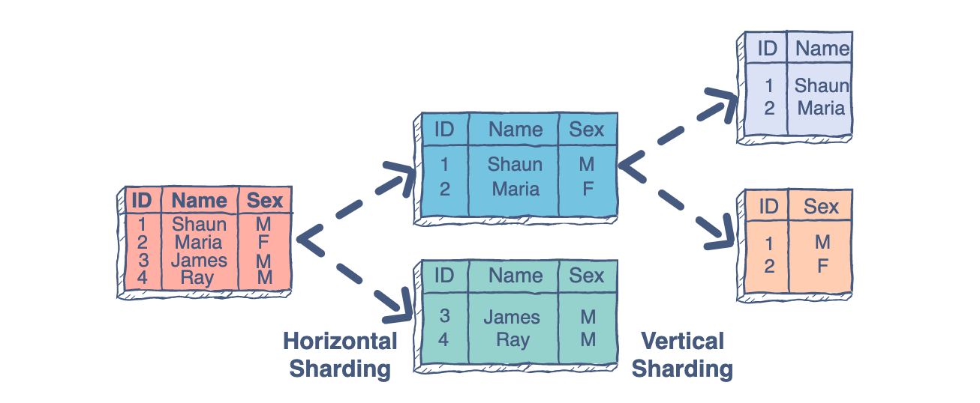
DATABASE SHARDING EXAMPLE
Some data within the database remains present in all shards (vertical sharding), but some appear only in single shards (horizontal sharding). The following figure illustrates vertical sharding and horizontal sharding.

Slide 12
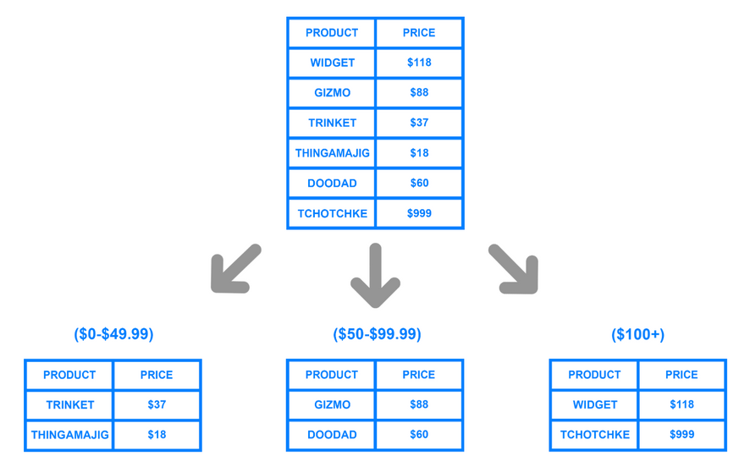
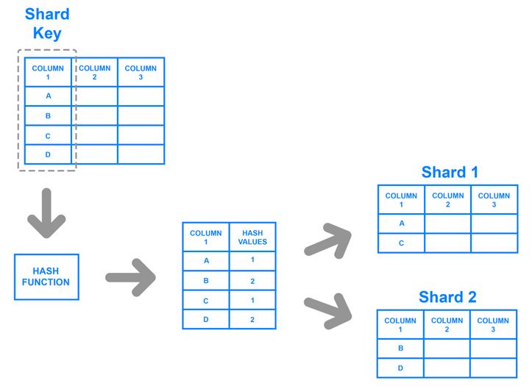
SHARDING ARCHITECTURES
Key Based Sharding
Range Based Sharding

Slide 13
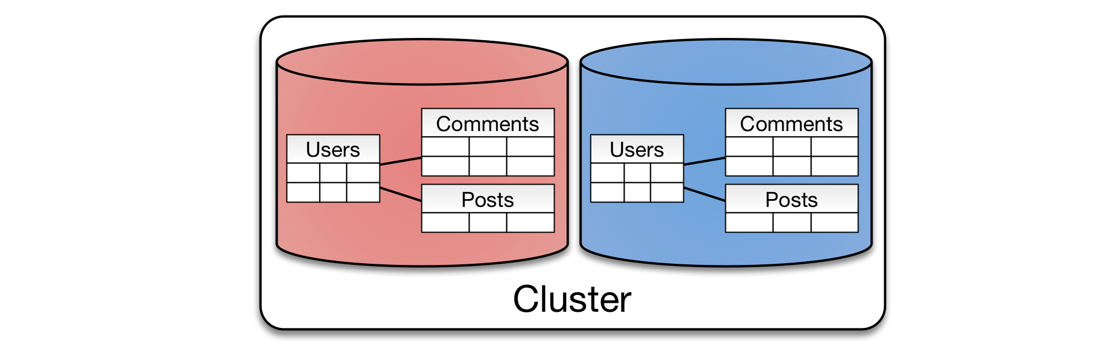
Sharding: Approaches
Data that is accessed together should be stored in the same node.
Queries within a single physical shard are efficient.
Stronger consistency semantics can be achieved within a shard.
If access is based on physical location, we can place data close to where it is accessed.
Another factor is trying to keep data balanced: We should arrange aggregates so they are evenly distributed in order that each node receive the same amount of the load.

Slide 14
Sharding: Approaches
In general, many NoSQL databases offers auto- sharding.
This can make much easier to use sharding in an application.
Sharding is especially valuable for performance because it improves read and write performances.
It scales read and writes on the different nodes of the same cluster.

Slide 15
Sharding: Right Time
Some databases are intended to be sharded at the beginning of development and certainly in production.
Some start with a single node, and then distribute and shard.
However, sharding very late may create trouble
especially if done in production, where the database became unavailable during the moving of the data to the new shards.

Slide 16
Distribution Models
Single Server
Sharding
Master-Slave Replication
Peer-to-Peer Replication
Combining Sharding and Replication

Slide 17
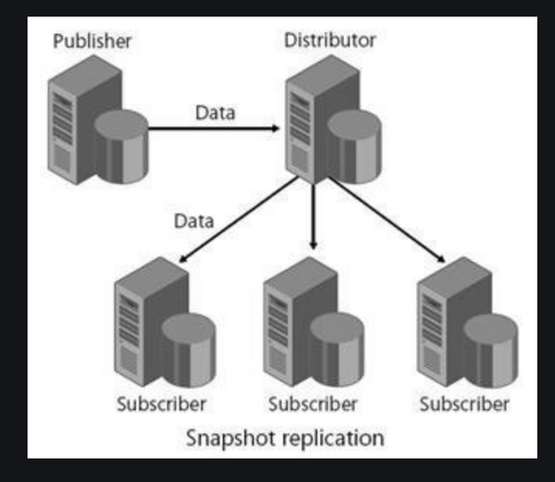
REPLICATION: WHAT IS IT?
Replication refers to a database configuration in which several copies of the same data set are housed on separate machines. The main reason for replication is redundancy.
Many of the advantages of using replication include fast recovery in the event of failure of one of the machines hosting the databases. A rapid fail-over to a secondary machine minimizes break time and keeping an active copy of the database acts as a backup to minimize data loss.

Slide 18
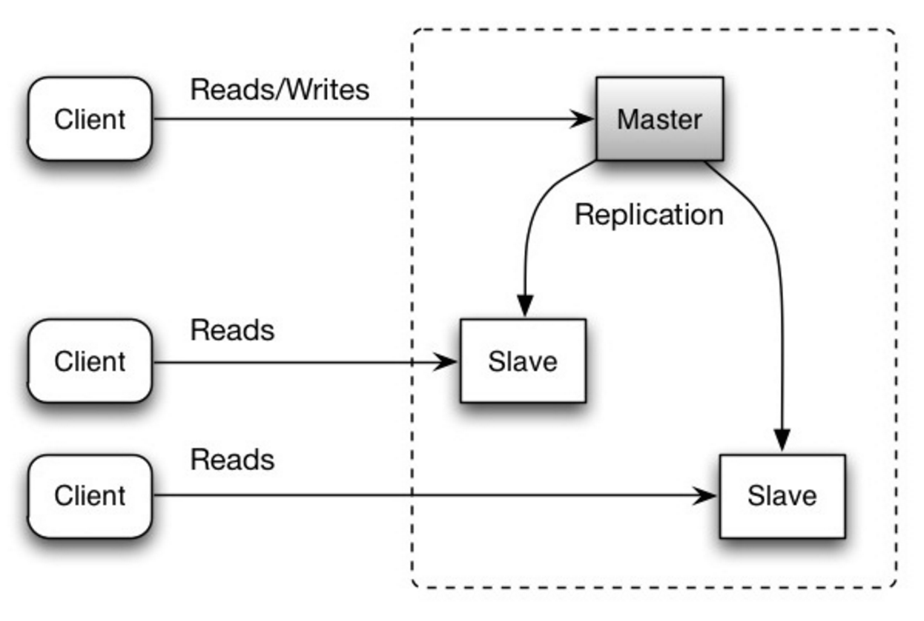
Master-Slave Replication
With Master-Slave Replication, we replicate data across multiple nodes.
Data is replicated from master to slaves.
The master service all write.
Reads may come from either master or slaves.

Slide 19

Analyze BENEFITS / LIMITATIONS of Master-Slave Replication

Slide 20
Is Master-Slave Replication more appropriate for read-intensive or write-intensive datasets?

Slide 21
To scale horizontally and to handle more reads, what can we do?

Slide 22
What-If the master fails:
how to handle read requests?
how about writes?

Slide 23

Master-Slave Replication is read resilience.
Slaves can handle read requests.
Writes are not allowed until the master restored
Recovery after a failure of a master is speeded up: a slave can be appointed as master, reducing downtime.

Slide 24

How about consistency or inconsistency issue?

Slide 25
Problem of inconsistency
Clients reading different slaves may see different values, because the changes haven’t all propagated to the slaves.
In the worst case, a client cannot read a write it just made.

Slide 26

Master-Slave Replication
Read scalability, but problem on scalability of writes.
Resilience against failure of a slave, but not of a master.
Master is still a single point of failure.

Slide 27
Distribution Models
Single Server
Sharding
Master-Slave Replication
Peer-to-Peer Replication
Combining Sharding and Replication

Slide 28
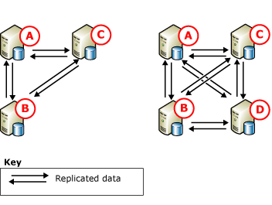
Peer-to-Peer Replication
Peer-to-Peer Replication overcomes to problems of Master-Slave Replication by NOT having a master.

Slide 29
Analyze BENEFITS / LIMITATIONS of Peer-to-Peer Replication

Slide 30
Peer-to-Peer Replication
It provides a scale-out and high-availability solution by maintaining copies of data across multiple nodes.
We can easily add nodes for performances.

Slide 31

Peer-to-Peer Replication
The biggest complication is consistency!!
When we can write on different nodes, we increase the probability to have inconsistency on writes.
Example: two clients attempt to write/update the same data at the same time: write-write conflict.

Slide 32
Distribution Models
Single Server
Sharding
Master-Slave Replication
Peer-to-Peer Replication
Combining Sharding and Replication

Slide 33
Combining Sharding and Replication
Sharding distributes data across multiple nodes. So each node acts as a single source for a subset of data.
Replication copies data across multiple nodes. So each bit of data can be found in multiple places.
We can have multiple masters, but each data item only has a single master.

Slide 34
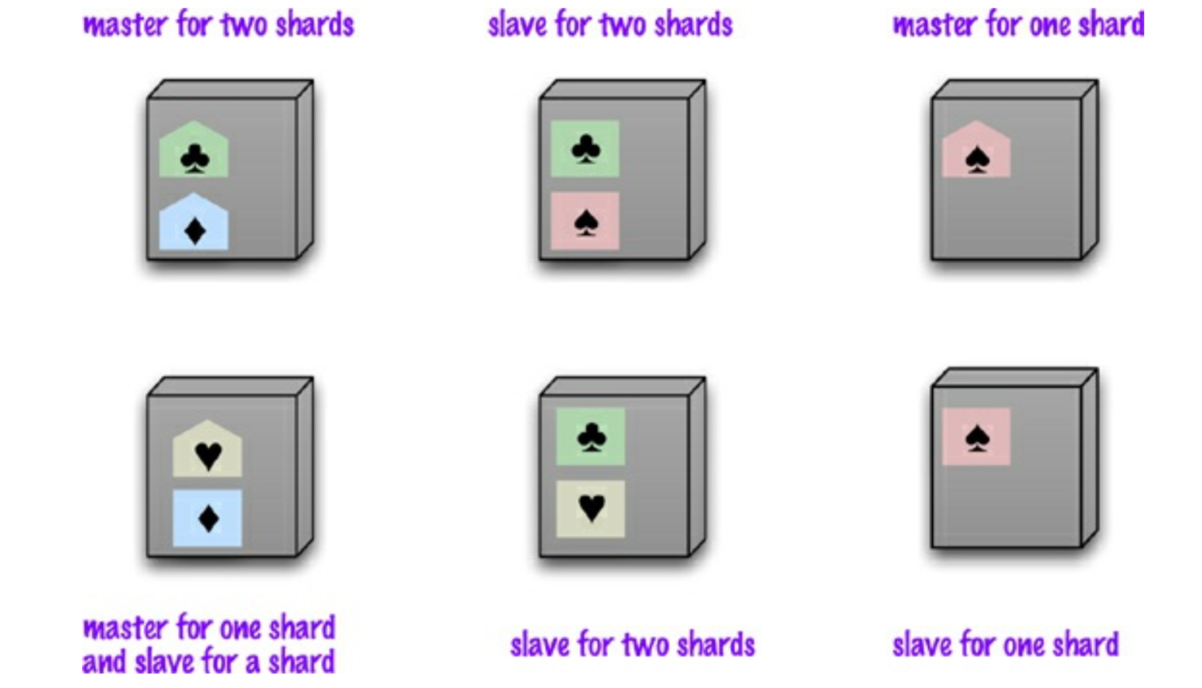
Combining Master-Slave Replication and Sharding

Slide 35
Combining Peer-to-Peer Replication and Sharding
A good starting point is to have a replication factor of 3, so each shard is present on 3 nodes.
If a node fails, a shard of that node will be built on other nodes.

Slide 36
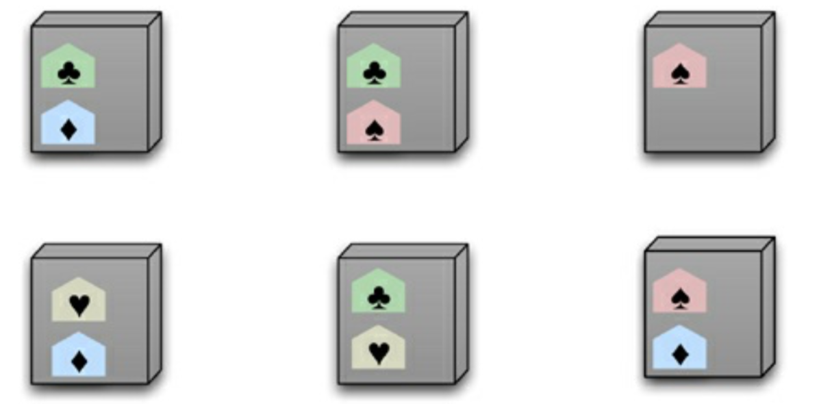
Combining Peer-to-Peer Replication and Sharding

Slide 37

P. Sadalage and M. Fowler: NoSQL Distilled: A Brief Guide to the Emerging World of Polyglot Persistence, Addison-Wesley Professional, 2013

Slide 38

Thank you.
Let’s Summarize!

